Slide 1
Data Analytics
Comcast Telecom Consumer Complaints

Slide 2
Business Scenario
Pin down what is wrong with Comcast's customer service

Slide 3
Objectives
Import data into Python environment.
Provide the trend chart for the number of complaints at monthly and daily granularity levels.
Provide a table with the frequency of complaint types.
Which complaint types are maximum i.e., around internet, network issues, or across any other domains.
Create a new categorical variable with value as Open and Closed. Open & Pending is to be categorized as Open and Closed & Solved is to be categorized as Closed.
Provide state wise status of complaints in a stacked bar chart. Use the categorized variable from Q3. Provide insights on:
Which state has the maximum complaints
Which state has the highest percentage of unresolved complaints
Provide the percentage of complaints resolved till date, which were received through the Internet and customer care calls.
The analysis results to be provided with insights wherever applicable.

Slide 4
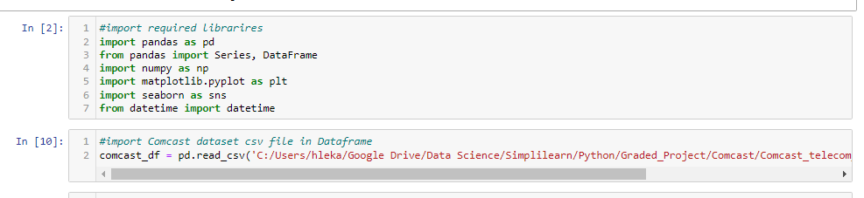
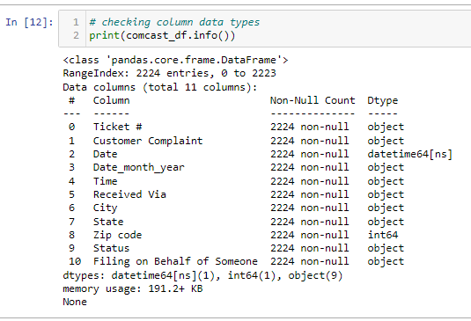
Data Availability
Ingest data
Data Preview

Slide 5
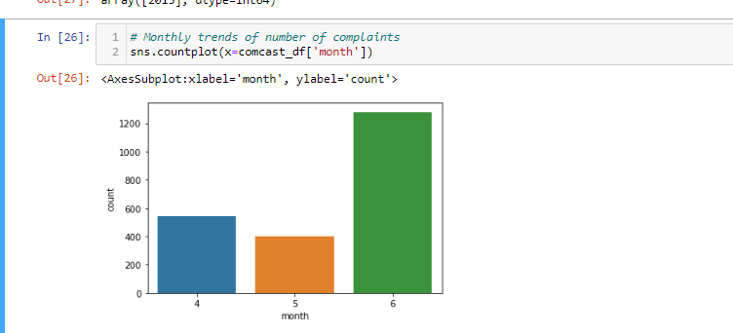
Data Exploitation: Monthly trends of number of complaints

Slide 6
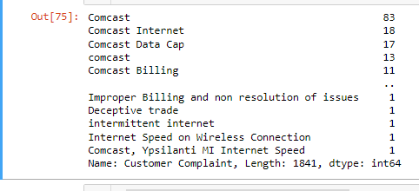
Data Exploitation - Frequency of complain types
# Frequency of complain types
comcast_df['Customer Complaint'].value_counts()

Slide 7
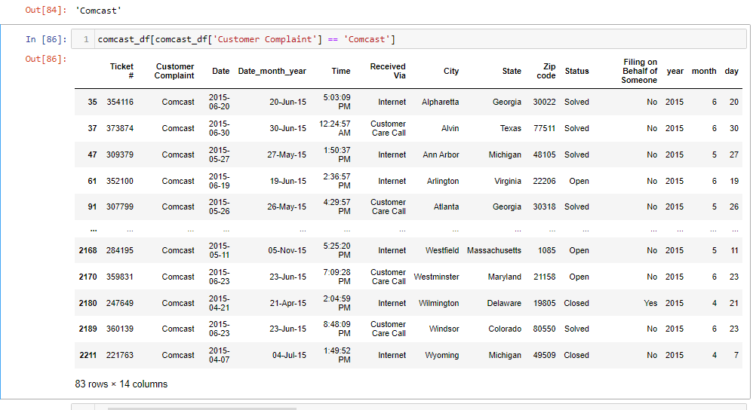
Data Exploitation - Complaints with the highest frequency
# Complaints with the highest frequency
comcast_df['Customer Complaint'].value_counts().index[0]

Slide 8
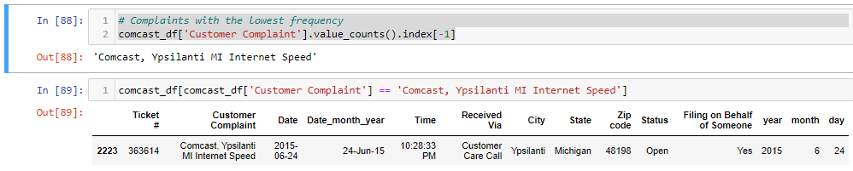
Data Exploitation - Complaints with the lowest frequency
# Complaints with the lowest frequency
comcast_df['Customer Complaint'].value_counts().index[-1]

Slide 9
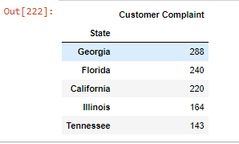
Data Exploitation – Complain by States
df = pd.DataFrame(data=chart)
df.sort_values(by=['Customer Complaint'], inplace=True, ascending=False)
df.head()

Slide 10

Data Exploitation - percentage of complaints resolved received through the Internet and customer care calls
(comcast_df['status_summary'].value_counts(normalize=True)) *100

